Slide 1
Neighbourhood
Planning

Slide 2
“I love Wells but I am concerned about its future. I feel detached from the political process and the neighbourhood plan gives me a chance to have a say.”
John Chettoe, Wells Neighbourhood Plan
#neighbourhoodplanning
Notes:
Transforming planning from a conversation over the heads of the community, albeit with consultation, to placing the views of the community on an equal footing for the first time.

Slide 3
“Planning has tended to exclude, rather than to include, people and communities
Planning policy itself has become so elaborate and forbidding – the preserve of specialists, rather than people in communities
We are allowing people and communities back into planning”
Rt Hon Greg Clark MP
National Planning Policy Framework (2012)
#neighbourhoodplanning
Notes:
Greg Clark, one of the architects of Localism, speaking in 2012 and making his views very clear.
Now SoS at DCLG – gives an idea of the priorities of the Department.

Slide 4
Neighbourhood Planning means:
The POWER to make planning policy or grant planning permission
Neighbourhood Plan
Local development plan
Local Plan
#neighbourhoodplanning
Notes:
How does a NP fit into the wider development plan?
Once a NP is made, or brought into force, it attains the same legal status as the LP for the area.
Planning decisions are made in line with the development plan for the area (i.e. NP and LP), together with any material considerations.
This is a first; the likes of Parish Plans which came previously did not have this status.

Slide 5
Process and Participation

Slide 6
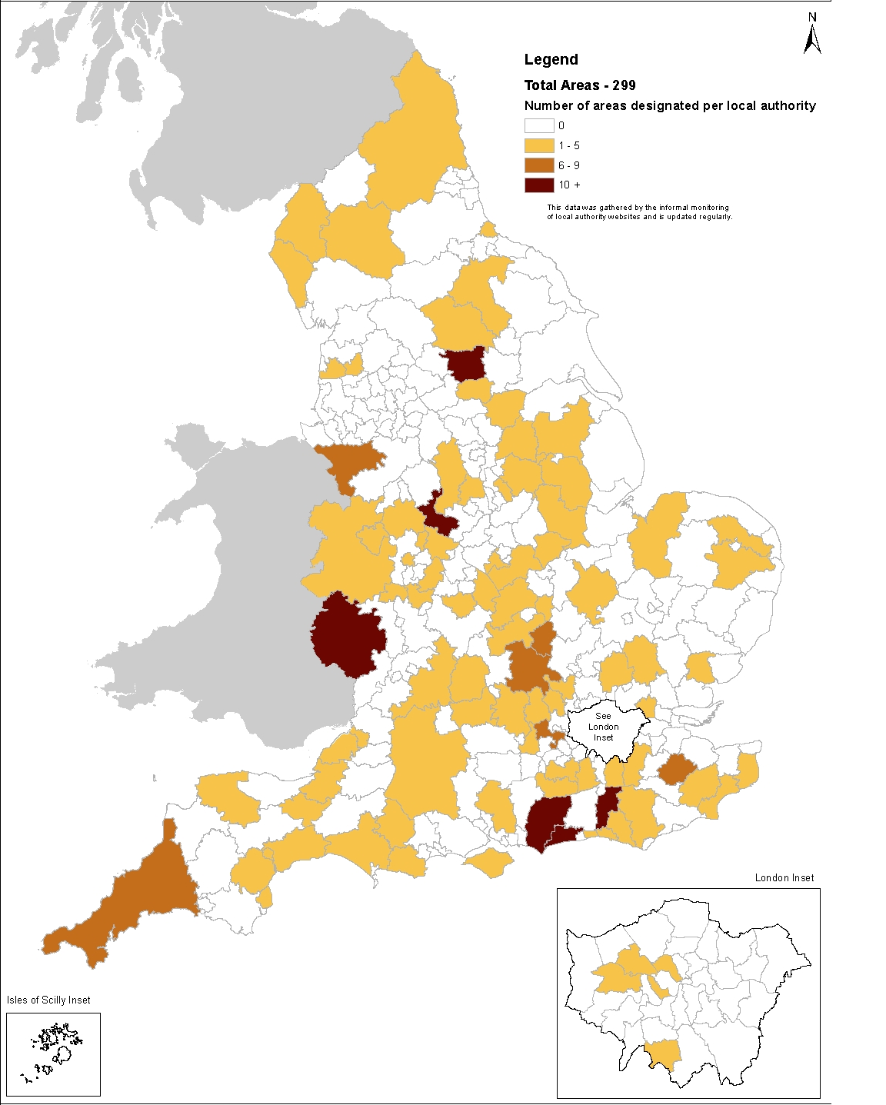
A growing movement
April 2013
Notes:
6
The regs came into force in 2012, with a number of ‘frontrunner’ communities leading the way.
This map shows the level of NP activity by LPA. The darker the area, the more activity.
The first referendum took place in Upper Eden, Cumbria in March 2013. 34% of the population, in the most sparsely populated area of England, turned out to vote. 90% of them voted in favour of the plan.

Slide 7
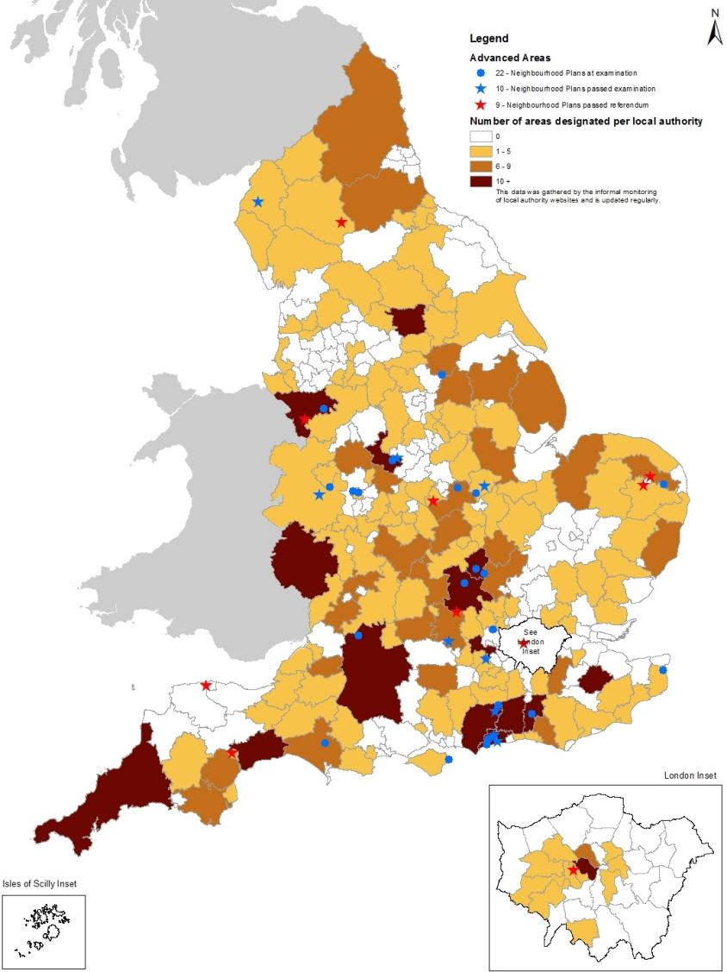
A growing movement
March 2014
Notes:
7
And by March 2014 we hit double figures, and you can see a lot more activity generally.

Slide 8
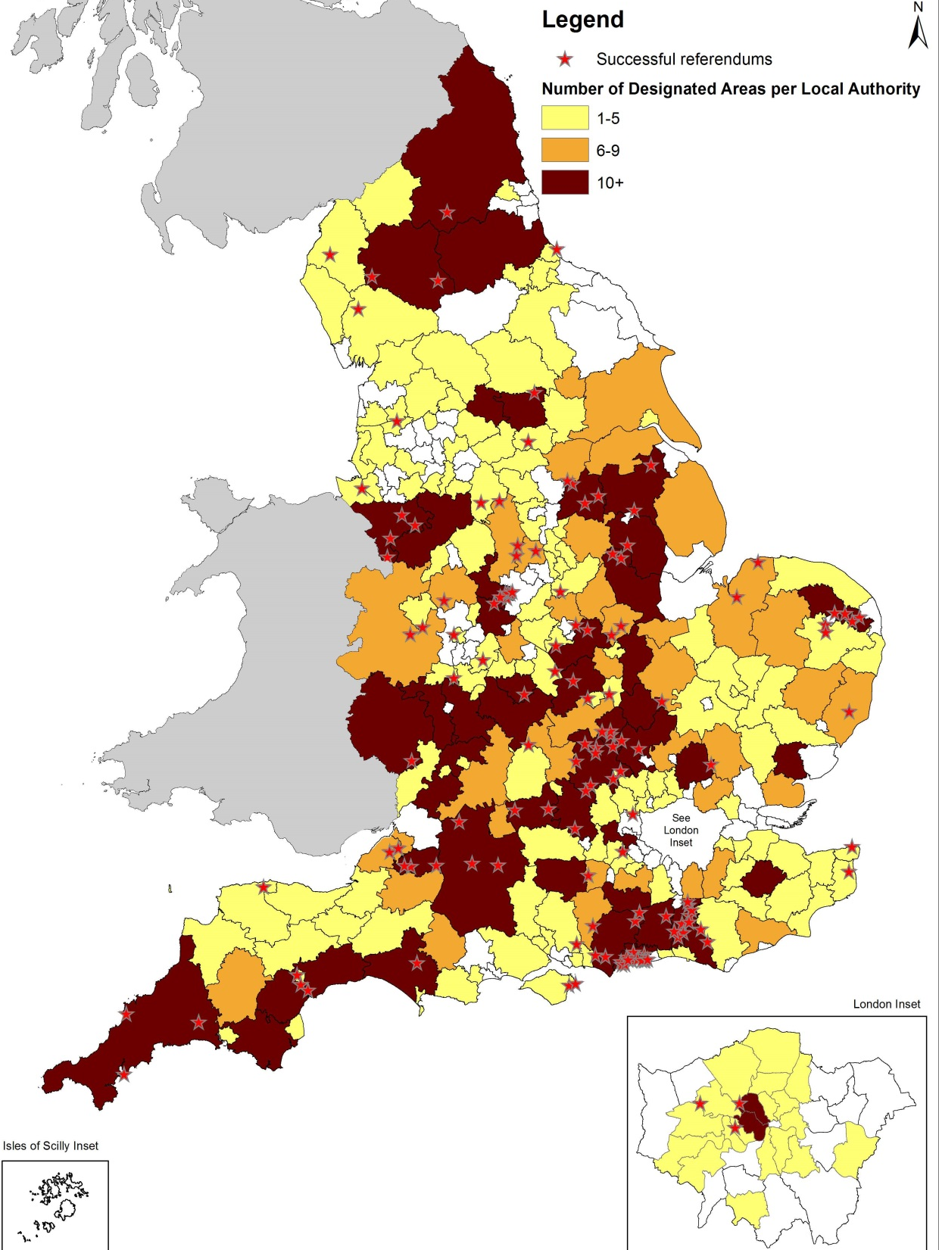
A growing movement
February 2016
Notes:
8
And fast forwarding to today, over 160 neighbourhood planning referendums have been held, all of them successful.
1,800 communities nationwide have begun the NP process – that covers nearly 10 million people, or 18% of the population of England.

Slide 9
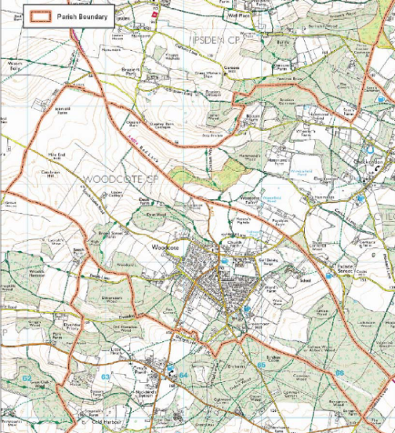
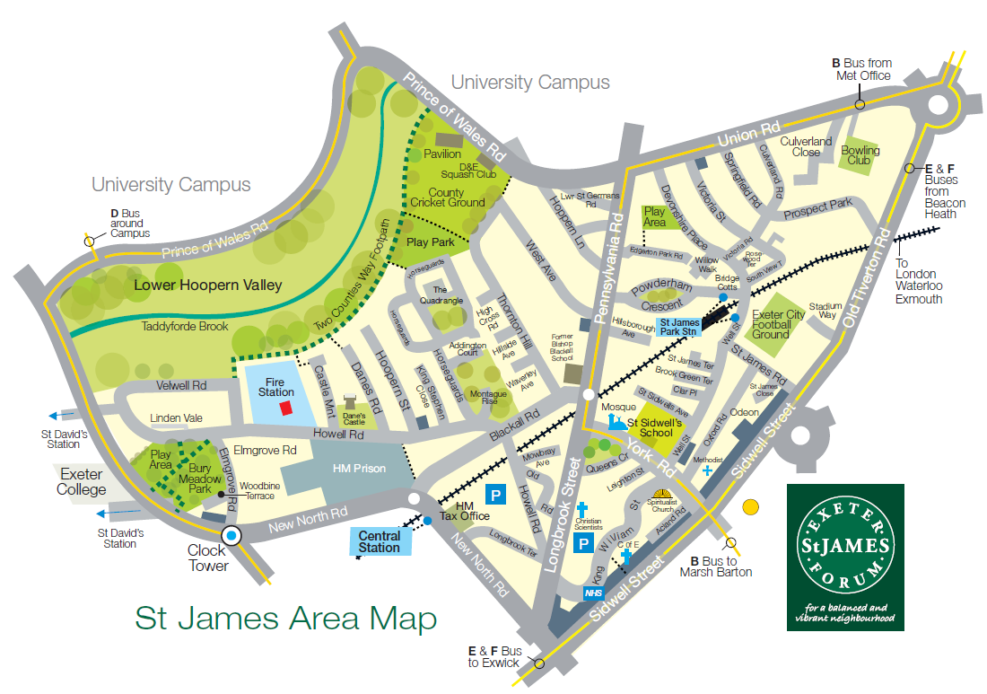
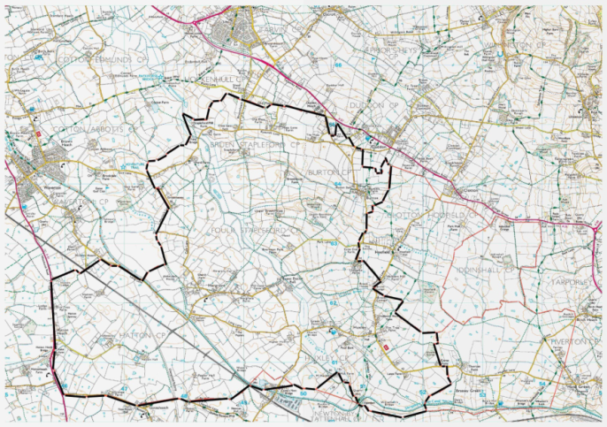
Designated areas
Woodcote NP conforms with existing parish boundary
St James NP covers a ward in the city of Exeter
Huxley & Foulk Stapleford NP covers several parishes
#neighbourhoodplanning
Notes:
Designation is the first formal step, and the first decision the LPA has to make.
Over two thirds of LPAs have now designated at least one area for NP.
[ask parishes/forums]
In areas that have one, the parish council will automatically be the qualifying body.
It is generally assumed that the boundary will follow that of the parish, around 90% do. [mention Housing Bill reforms]
In unparished areas, a Neighbourhood Forum will need to be set up [21 members, open membership etc]. Top right shows Exeter St James, which follows the ward boundary.
Other parishes may decide to work together in a cluster, like in the bottom picture. There is extra support available for parishes that decide to do so.

Slide 10
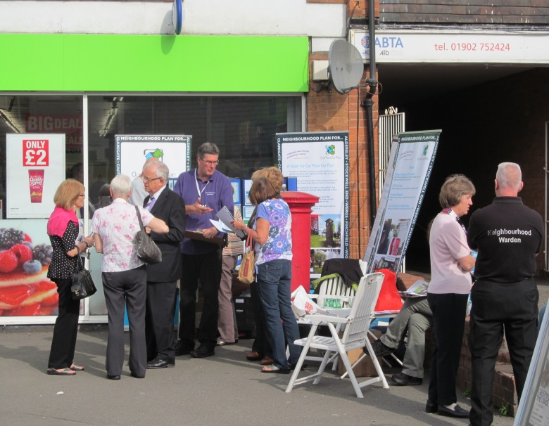
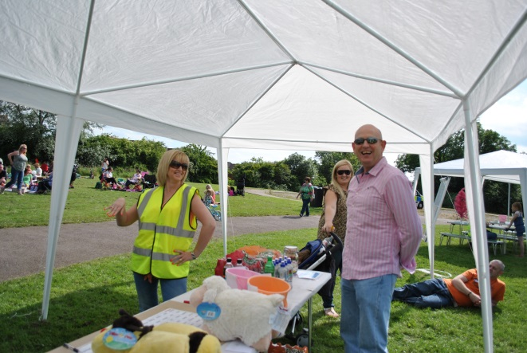
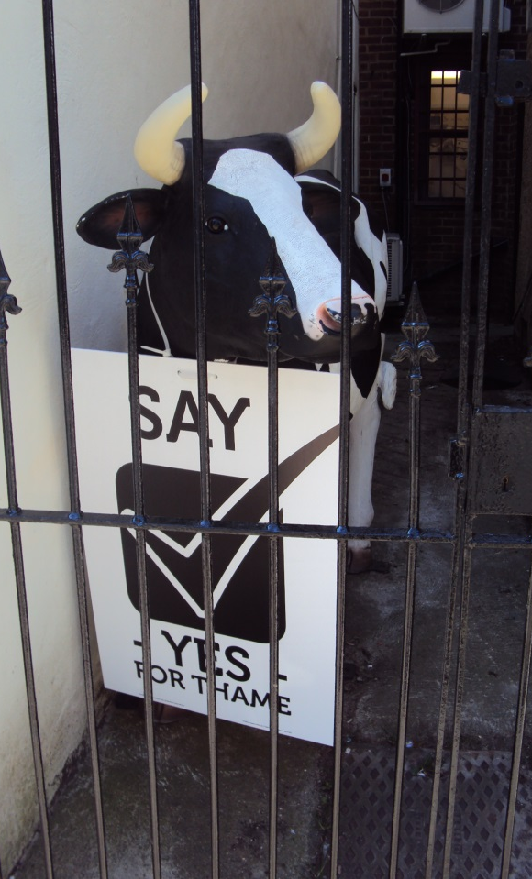
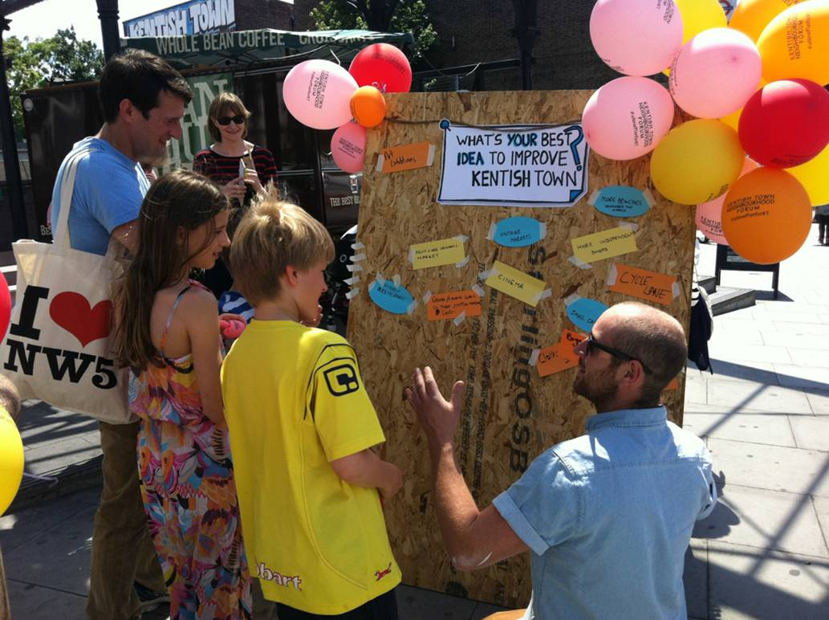
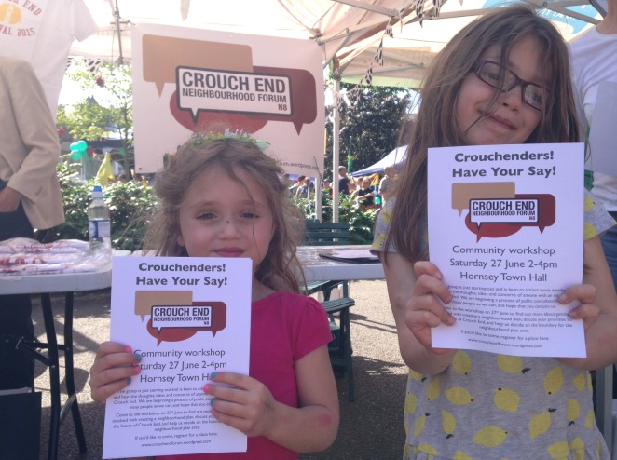
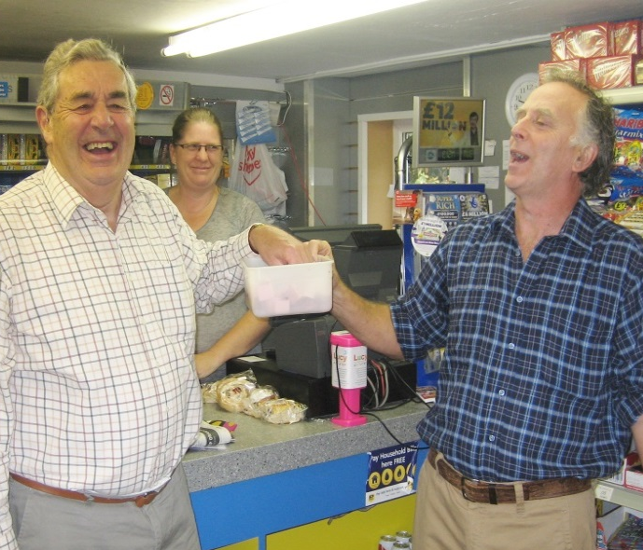
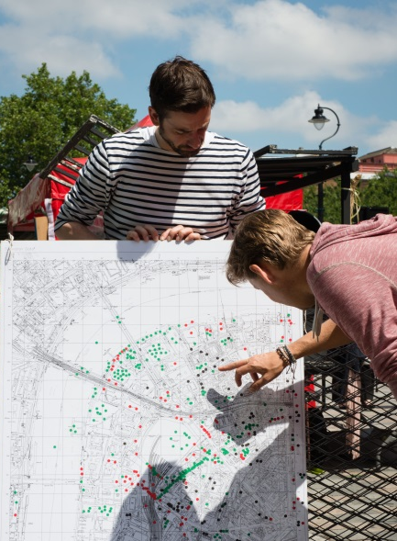
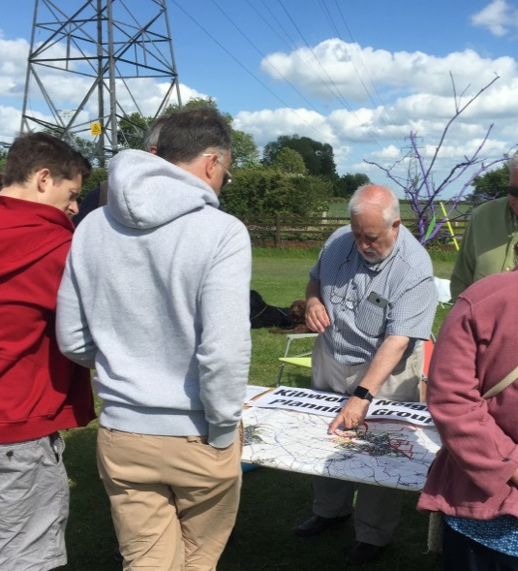
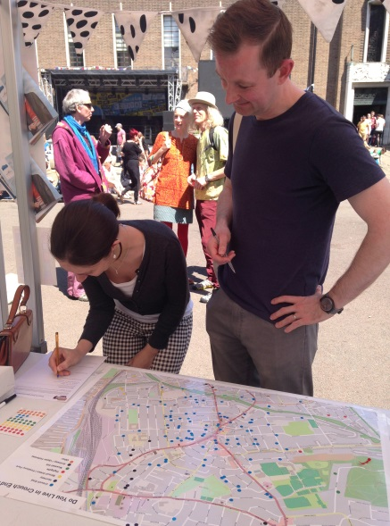
Notes:
From the outset, consultation and engagement should be guiding the process.
The are regulatory consultation periods built into the process (designation, pre-sub, publicity), but the community should be consulted early and consistently, as it is this which will be informing your vision, objectives and policies.

Slide 11
“We have spent a year engaging with residents in a whole range of ways, everything from attending school parents’ evenings, to translating the information into Polish. We wanted everyone to have an input”
Cllr Matthew Brown, cabinet member for community engagement, Preston on Fishwick & St Matthews
The writing’s on the wall (Downham Market)
Charrette
(Kirdford)
Chair bombing
(Headington)
Postcard competition (Winsford)
Rave
(Tattenhall)
3D models
(Heathfield Park)
Stadium tours
Street champions
School projects
Village fete
NP tour bus
Raffle
#neighbourhoodplanning
Notes:
Each community will know the best way to reach their own members. However we have seen some really innovative examples across the country:
Downham (Community hall set to be refurbished, invited community in graffiti the walls with their wishes for the area, before painting it over).
Kirdford (Intensive planning sessions, workshops held with architects, consultants etc)
Headington (Put seats out in the high street and invite people to sit down for a chat about the area while doing their Saturday shopping)
Winsford (Postcards of favourite things about the town, winners made it into the Plan)
Tattenhall (price of entry = filling in questionnaire)
HFP (community organisation worked with people from the estate using 3D printers to create models of current and proposed developments.
But number of everyday methods
- Reach large numbers of people by hijacking the membership of existing networks and clubs
Online engagement increasingly important, particularly in reaching younger people. A website should be ready from the outset, with good content and regularly updated. If people look at the website and it’s threadbare, they’re unlikely to visit it again, even if you have since added content. Social media, particularly Twitter. Reaching the community, following and engaging in local discussion. #NeighbourhoodPlanning.
Local press/posters.
At meetings and events, have a sign-up sheet. Encourage attendees to leave their contact details, any specific skills, how much time they’re willing to volunteer etc.
Businesses, schools, village fetes, landowners, developers, LPA (mention our resources on working with LPA/developers/landowners)

Slide 12
400
Draft neighbourhood plans
Notes:
Eventually leads to a draft plan. 6 weeks consultation, held by qualifying body.

Slide 13
300
Submitted for examination

Slide 14
Examination
#neighbourhoodplanning
Notes:
Once representations from pre-sub taken on board, and any resulting revisions made - submit plan to LPA with basic conditions statement/consultation statement (who you spoke to, what they said, what you did about it) and environmental statement.
More ‘light touch’ than LP examination.
Examiner tests policies against the basic conditions. Should be at forefront of mind when writing plan (and help the examiner out in the basic conditions statement)

Slide 15
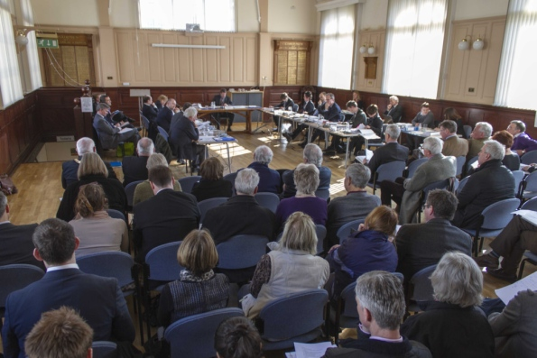
Thame Examination Hearing
Notes:
Examination usually carried out via written representations, but examiner may decide to hold a hearing to clarify points. Roughly a third of cases so far.
Examiner will fail, pass or pass with modifications. Almost none pass without modifications so don’t be disheartened by ‘red pen’ on the plan.
If fail, not necessarily the end of the road [go back to points of failure and try again/ LPA may still agree to proceed]

Slide 16
200
Passed examination
Notes:
Over 200 plans out there which have passed the basic conditions. Great source for NPers following behind, and likely to be one in a similar area wanting to do similar things.
If LPA agree, issue decision statement to proceed to referendum.

Slide 17
Referendum
"Do you want [local planning authority] to use the neighbourhood plan for [neighbourhood area] to help it decide planning applications in the neighbourhood area?"
#neighbourhoodplanning
Notes:
LPA will organise and pay for referendum (funded by DCLG)
This is the wording your community will vote on. Worth familiarising people with the wording early to avoid any confusion.
Campaigning restrictions, compounds need to make people aware of NP early, not desperately try to tell everybody in the 2 weeks before referendum.

Slide 18
Notes:
Numbers rising every week, but summary of where we are now.
300,000+ votes cast

Slide 19
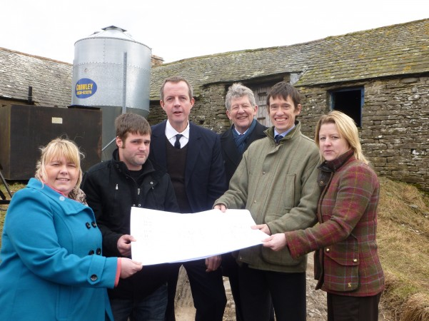
Planning Application
Notes:
Final step, LPA make, or bring into force, the plan. At that point it becomes part of the development plan for the area.
This was in the site of the country’s first in Upper Eden.
In areas with a CIL charging schedule in place, the Parish will then be entitled to 25% of receipts for their NP area.

Slide 20
Content and Analysis

Slide 21
Size doesn’t matter
Notes:
Huge range. Larger areas may have increased costs, reflected in new support programme.

Slide 22
Size doesn’t matter
Number of policies per plan passed referendum
Notes:
Huge range in scale of plans. May want to address very specific issues with a one or two policy plan, or cover every eventuality.
Danger of trying to do too much and ended up doing nothing.
Also avoid creating extra work by duplication what’s already in the Local Plan.
Key thing to bear in mind – will it make a difference?

Slide 23
The Power of Neighbourhood Planning
Neighbourhood planning policies can cover a broad spectrum of issues:
Choose where new housing should go and what it should look like
Encourage new employment uses
Protect and enhance the High Street
Decide how community infrastructure levy money is spent
Protect and enhance green spaces
Define and secure local heritage
#neighbourhoodplanning
Notes:
NPs covering a broad range of issues.
Design, housing and transport particularly important topics. Over half allocate housing sites.

Slide 24
Policy Analysis
89%
Of made plans contain policies to shape new housing development
54%
Of made plans allocate sites for new housing
51%
Of made plans encourage new employment uses
The Average Plan
Policies | 19
Themes | 10
Sub-themes | 38
Top 5 Policies
Promote local distinctiveness
Parking Standards
Pedestrian & cycle routes
Scale, height and density of new developments
Affordable Housing
Notes:
Look at what the NPs that have been brought into force are doing
Design, housing and transport particularly important topics. Over half allocate housing sites.

Slide 25
Cost
In the small coastal village of Lympstone: £6,389
In the large village of Broughton Astley: £14,312
In the Exeter ward of St James: £10,450
In the deprived urban area of Heathfield Park: £19,500
In the coastal towns of Lynton & Lynmouth: £27,681
In the small Norfolk village of Strumpshaw: £4,220
Average: £13,758
#neighbourhoodplanning
Notes:
Small sample, but possibly less than you’d think.
Costs can be controlled.
Dependent on scale of plan and resources within community.
Financial support is available.

Slide 26
Sample of spend
£5,000 Project planning advice & Graphic design
£3,820 Rural Community Council (consultation events, design/analysis of survey) £3,035 Printing & distribution £360 Advertising in newspapers £210 Environmental data from Council £130 Postage
TOTAL SPEND: £14,312
Notes:
Plan allocated sites for over 500 houses.

Slide 27
What do we know?
1800 communities started the process. 18% of the population.
87%/13% parish/forum split
27% of designated areas are in the 30% most deprived LA areas in England.
It is possible to start, progress and complete the process irrespective of who or where you are.
People will engage, turn up and vote ‘for housing’. They will also use it as a foundation for wider thinking about their community and as a springboard for community action.
Average ‘Yes’ vote: 89%
Average turnout: 32%
89% of made NPs contain policies to direct the shape of new housing developments;
54% of NPs contain site allocation policies;
90% of NPs have design policies.
The process takes time and is harder for some groups.
Complexity of plan & location can impact significantly.
#neighbourhoodplanning
Notes:
Lessons learned. Proven concept. More complex in certain areas, but it has been proven to work in urban/rural/affluent/deprived/business/national parks/coastal, N, E, S and W. etc.
On 8 October 98, 99 and 100th referendums took place – all 3 led by Forums.

Slide 28
What happened next?
Catalyst to engagement - In Exeter St James, the neighbourhood forum has formed a Community Trust to manage aspirational projects identified within its plan. It has already renovated a communal garden space, and intends to work next on allotments and sustainable homes.
Changing attitudes - In Woodcote, the neighbourhood plan helped turn local attitude towards development around from 70% against to 90% in favour, because the community now felt in control of potential development, rather than at its mercy.
Catalyst to further work – In Uppingham, the community is now working on a Town Centre and Business Zone Plan to enhance and shape economic development of the town.
Improving relations – the process of making a neighbourhood planning brings communities together and also improves their working relationship with local authorities.
#neighbourhoodplanning
Notes:
We’ve seen a number of positive impacts as a result of NP, often outside of the scope of the policies themselves.
From building social capital, to helping appropriate planning applications go through with far fewer objections.

Slide 29
Support

Slide 30
Manifesto commitments
We will encourage the 1,400 communities engaged in neighbourhood planning to complete the process and assist others to draw up their own plans.
Let local people have more say on local planning and let them vote on local issues.
#neighbourhoodplanning
Notes:
Pre-election Conservative manifesto highlights Govt commitment to the policy.

Slide 31
Housing & Planning Act
To simplify and speed up the neighbourhood planning system, to support communities that seek to meet local housing and other development needs through neighbourhood planning.
#neighbourhoodplanning
Notes:
Pre-election Conservative manifesto highlighted Govt commitment to the policy, and the Queen’s Speech further signaled intent.
Housing & Planning Act contains measures aimed at speeding up and simplifying the NP process.
Includes powers to:
Set time periods for key Local Planning Authority decisions (designation and referendum)
Provide a simpler and more automatic process for designating an area
Provide new powers for the Secretary of State to intervene where plan progress is blocked following an independent examination.
Give neighbourhood forums the right to be notified of planning applications in their area.

Slide 32
Neighbourhood Planning mobilisation
To raise awareness and take up of neighbourhood planning
Refreshed Neighbourhood Planning Champions Network
Roadshows delivered by CPRE / ACRE.
Capacity building programme for community organisations in deprived areas
Joint Cabinet Office project working with Community Organisers in deprived areas
National promotional campaign…
#neighbourhoodplanning
Notes:
We want to make sure as many people as possible are able to take advantage of the benefits of NP.
5 different activities to deliver this aim:
Advocacy and peer-to-peer support via refreshed Neighbourhood Planning Champions Network. From 50 to 135. Two residential events. Ambition for them to be our advocates, support emerging groups, run local networks.
These roadshows delivered by CPRE and ACRE to reach parishes particularly in the areas where there’s been less take up
Building capacity and take up in deprived urban areas by training community organisations to be able to lead neighbourhood planning in their neighbourhoods.
Working with Community Organisers to use neighbourhood planning to tackle issues faced by communities in deprived urban areas. Jointly funded DCLG/Cabinet Office project.
National promotional campaign. Tackles the fundamental issue that people don’t take up NP because they don’t know about it. Channels include local papers, radio, online advertising, bus stop posters and billboards.

Slide 33
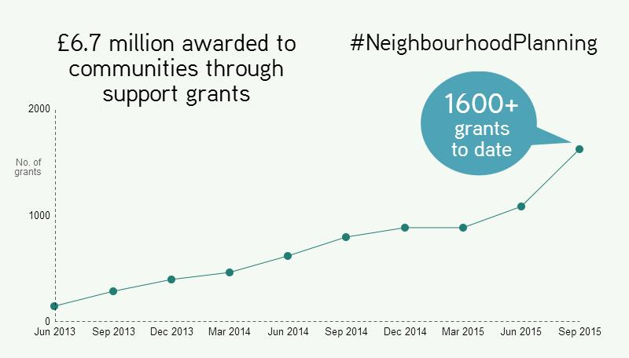
Resources for Communities
£22.5million, 3 year programme of grants for communities preparing a neighbourhood plan.
All groups can apply for up to £89,000
Groups in ‘priority areas’ further £6,000 plus direct support
#neighbourhoodplanning
Notes:
Represents 50% increase in value of support programme. Wipes the slate clean for groups applying for support.
From 1 April, we’re increasing the basic grant limit from £8k to £9k per group.
Priority areas include Forums, deprived areas, clusters, high-growth, business, NDOs and those with a population in excess of 25,000.
Aside from financial support, a huge suite of resources is available. Most can be found on MyCommunity.org.uk

Slide 34
Resources for Authorities
A new £12million pot to assist LPAs in their duty to provide advice and assistance to communities.
Each LPA receives £30,000 per group:
£5,000 at designation (plus £5k per designated Forum)
£5,000 at submission
£20,000 after successful examination (plus £10k per business area)
#neighbourhoodplanning
Notes:
LPA duty to support – organising exam/referendum, but also advising and assisting.

Slide 35
Tools, templates & support
http://bit.ly/1JbVR4h
www.mycommunity.org.uk
#neighbourhoodplanning
Notes:
Practical resources available to provide help at every stage of the process.

Slide 36
Peer Support
http://bit.ly/1gVcMbg
#neighbourhoodplanning
Notes:
Over 1800 groups are out there doing the same thing. 200 have plans that have passed examination to learn from.
Map shows recently relaunched NP Champions network. 130 individuals at forefront of NP in their areas, volunteering to offer their expertise and experience to local groups. You can find your local Champion via the link in the slide, or email the team to be put in touch.
Wherever you are, there’s likely to be similar community, facing similar challenges, or wanting to do similar things.

Slide 37
Locality
www.mycommunity.org.uk
Planning Guidance
planningguidance.planningportal.gov.uk
decentralisation@communities.gsi.gov.uk
#neighbourhoodplanning
Notes:
Locality site first stop.
Most queries can be answered by planning guidance. We’ve just updated this to clarify the position on several key issues. Particularly on the weight of a NP where there is no 5 YLS, the evidence needed to support a NP, and the ability for parish councils to create sub-committees. We have also further clarified the issue of a NP coming before a LP is in place.
Can also get in touch with team.

